Slide 1


CHAPTER 17
REPRODUCTION IN HUMANS
The following content has not been through the Cambridge Assessment International Education endorsement process.

Slide 2
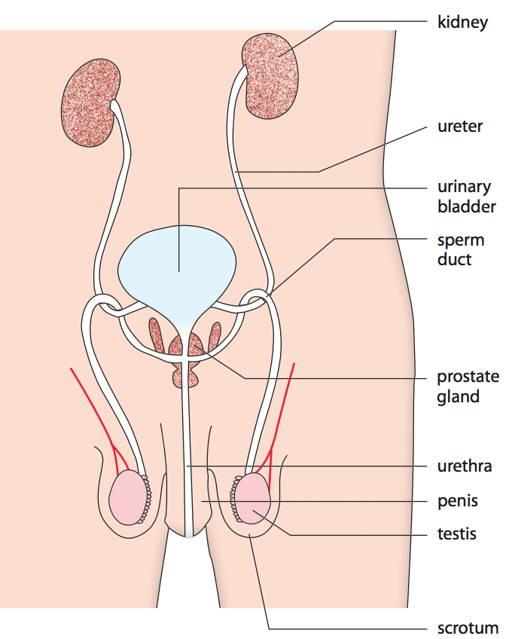
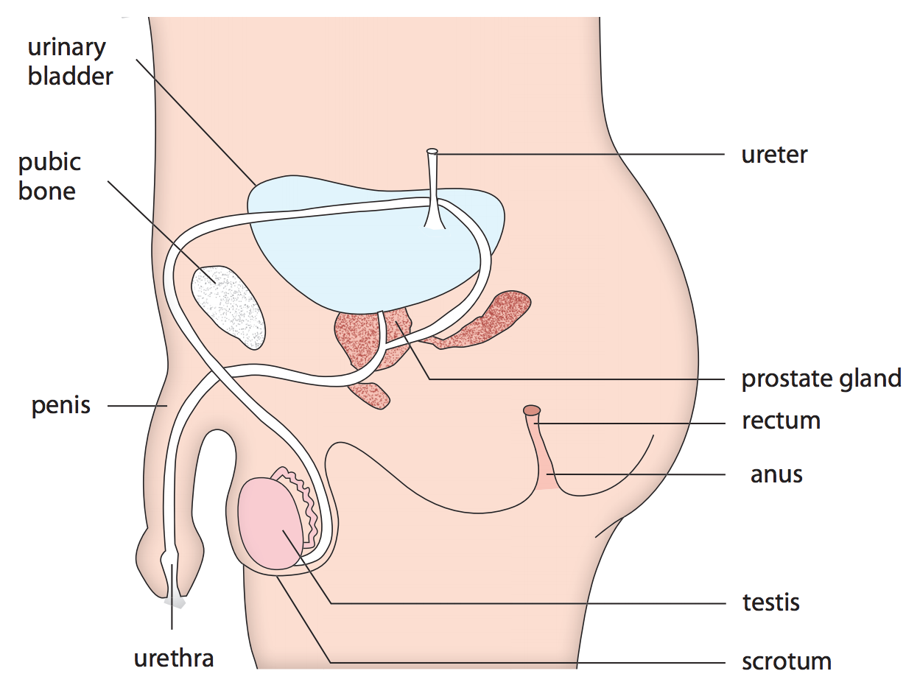
The male reproductive system
Side view of the male reproductive system
Front view of the male reproductive system
Notes:
Introduce to students the male reproductive system by referring them to the diagrams (Figure 17.1 on Student’s Book 292 and Figure 17.2 on Student’s Book p. 293).

Slide 3
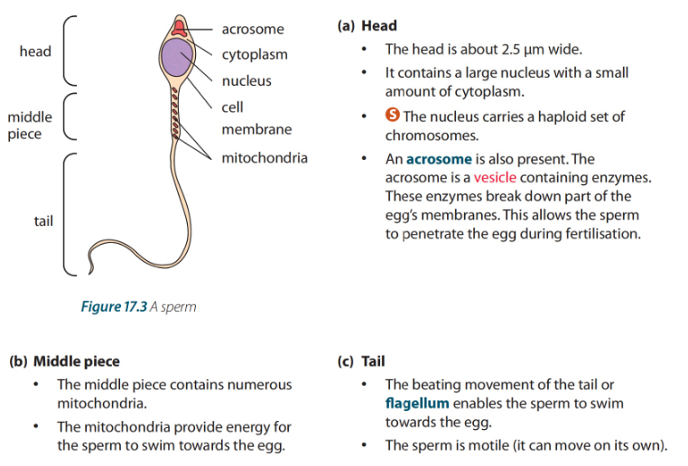

Sperm
Movement of sperm from a testis:
Notes:
Discuss with students the structure of a sperm using the diagram (Figure 17.3 on Student’s Book p. 293).
Explain to students the movement of sperm from a testis by referring them to the flowchart.
Have students answer the question in Quick Check on Student’s Book p. 293.

Slide 4
Male Reproductive System
Two testes: lie in a special sac called the scrotum.
Function:
Produce sperms.
release male hormones.
Scrotum: a sac which encases the testes. It provides a temperature slightly below the normal body temperature (best temperature for sperm production.
Epididymis: a coiled tube on the outside of the testis.
Function: it stores sperms from testes. when it contracts, it pushes sperms into the sperm duct.

Slide 5
Male Reproductive System
Sperm ducts: one from each testis. These are muscular tubes which open into the top of the urethra.
Function: when sperm ducts contract, they force sperms out through the urethra.
Seminal vesicle and prostate gland: add fluid to sperms; The fluid plus the sperms it contains is called semen;
Erectile tissue: a connective tissue with many blood vessels round the urethra in penis. Erection is the result of blood flowing in the erectile tissue.

Slide 6
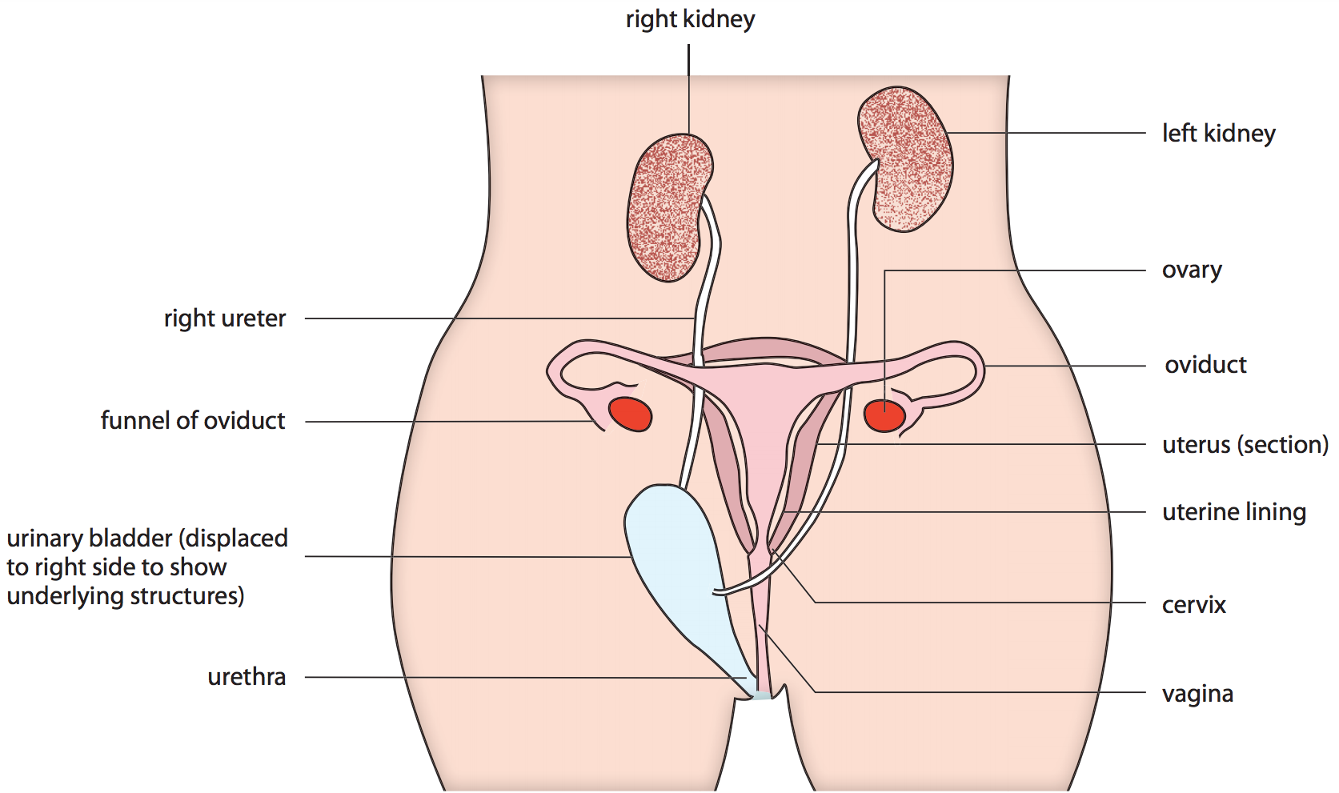
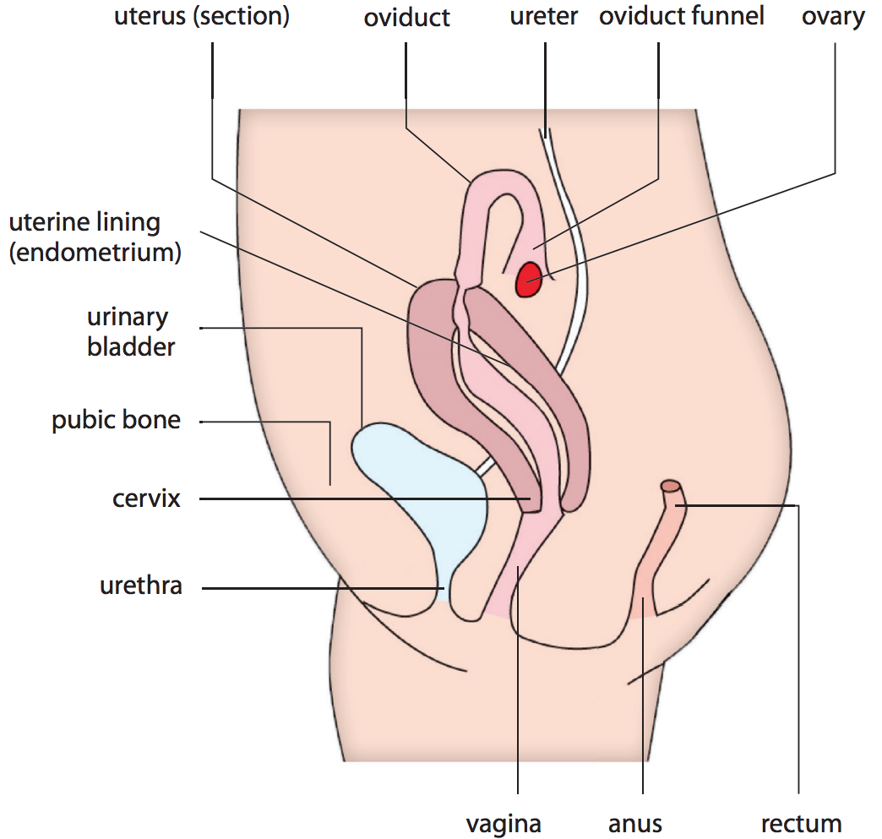
The female reproductive system
Front view of the female reproductive system
Side view of the female reproductive system
Notes:
Introduce to students the female reproductive system by referring them to the diagrams (Figure 17.4 on Student’s Book 294 and Figure 17.5 on Student’s Book p. 295).

Slide 7
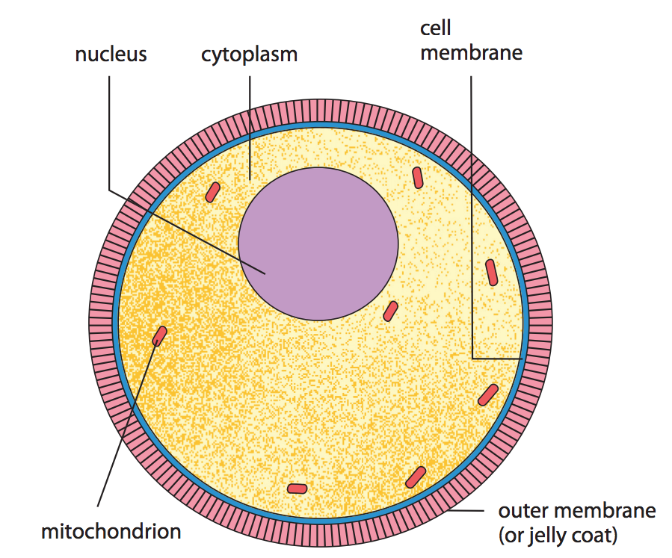
Ovum
An egg
Notes:
Discuss with students the structure of the ovum using the diagram (Figure 17.6 on Student’s Book p. 295).
Have students answer the question in Quick Check on Student’s Book p. 295.

Slide 8
Female Reproductive System
Ovaries: two oval bodies, lie in the lower part of the abdomen. Function: produce the ova release hormones into the blood stream.
Oviducts: two tubes, one from each ovary, which transport ova from the ovaries. The opening of an oviduct has a funnel-shape close to the ovary.
Fertilization occurs in the oviduct. The fertilized ovum moves down the oviduct to the uterus by the beating action of cilia in the oviduct.

Slide 9
Female Reproductive System
Uterus or womb : a wide tube, where the embryo develops. It consists of external muscle layer and inside lining which is made up of blood vessels.
Cervix: is a ring of muscle closing the end of the uterus
Vagina: is a muscular tube where male’s penis enters.
Ejaculation of semen (or sperms) occurs at the top of the vagina

Slide 10
What are the differences between male and female gametes?
Differences between male and female gametes
Feature | Male gamete | Female gamete
Structure | Has a head, a middle piece and a tail Nucleus contains either X and Y chromosome About 60 μm long, with a head that has a diameter of 2.5 μm | Spherical in shape Nucleus has one X chromosome Diameter of 120–150 μm
Motility | Motile Has a tail that enables it to swim towards the oviduct | Non-motile Passive movement of egg along the oviduct is due to the action of cilia along the oviduct and peristalsis of the oviduct wall.
Number | Numerous sperm are produced throughout life from puberty onwards. A large number of sperm is released per ejaculation. | Number of eggs is determined at birth. Only one egg is released per month. Both ovaries together produce about 500 mature eggs.
Notes:
Explain to students the differences between male and female gametes using the table (Table 17.1 on Student’s Book p. 296).

Slide 11
What is puberty?
Puberty is the stage of human growth and development in which a person is physically mature.
Secondary sexual characteristics
Males | Females
Facial hair starts to grow. Hair appears in the pubic region and under armpits. | Hair appears in the pubic region and under armpits.
The penis and testicles increase in size. | The breasts and uterus enlarge.
Larynx enlarges and voice deepens. | Hips broaden.
Production of sperm starts. | Menstruation and ovulation start.
Notes:
Explain to students the changes that take place in male and female bodies during puberty using the table (Table 17.2 on Student’s Book p. 297).

Slide 12
The menstrual cycle
A sign of puberty for a female is usually the monthly discharge of blood or menses from the uterus via the vagina. This is called menstruation.
Menstrual cycle is the cycle of events that takes place in the female reproductive organs every month. The average menstrual cycle is 28 days, but this can vary.
As a female ages, the ovaries will eventually stop releasing eggs and the menstrual cycle will stop. This is called menopause. Menopause usually takes place between 45 and 55 years of age.
Notes:
Introduce to students the menstrual cycle and explain the natural variation in the menstrual cycle.

Slide 13
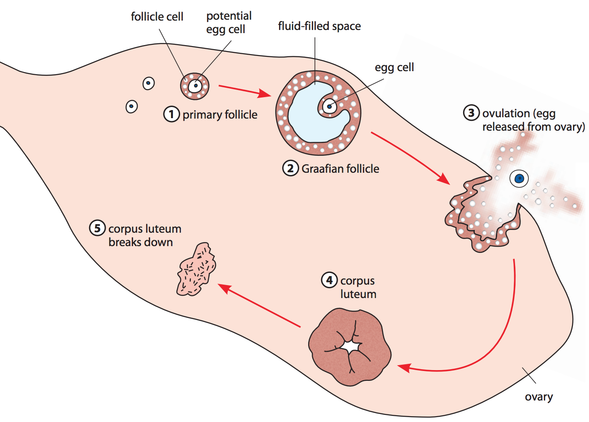
What are the changes in a follicle during the menstrual cycle?
Section of a human ovary showing changes in one follicle during a menstrual cycle
Notes:
Explain to students the changes in a follicle during the menstrual cycle by referring them to the diagram (Figure 17.8 on Student’s Book p. 298).

Slide 14
Changes of the follicle during the menstrual cycle
Stage | Change
Primary follicle | Consists of potential egg cell surrounded by follicle cells
Graafian follicle | Consists of egg cell surrounded by follicle cells and fluid filled space.usually one egg is released every month
Ovulation | On day 14 of 28 menstrual cycle, Graafian follicle ruptures, the egg is released into the oviduct
Corpus luteum | Rest of graafian follicle turns into corpus luteum that produces hormones that prepare body for pregnancy
Breaking of corpus luteum | If no fertilization, the corpus luteum persists for some time then eventually breaks down

Slide 15
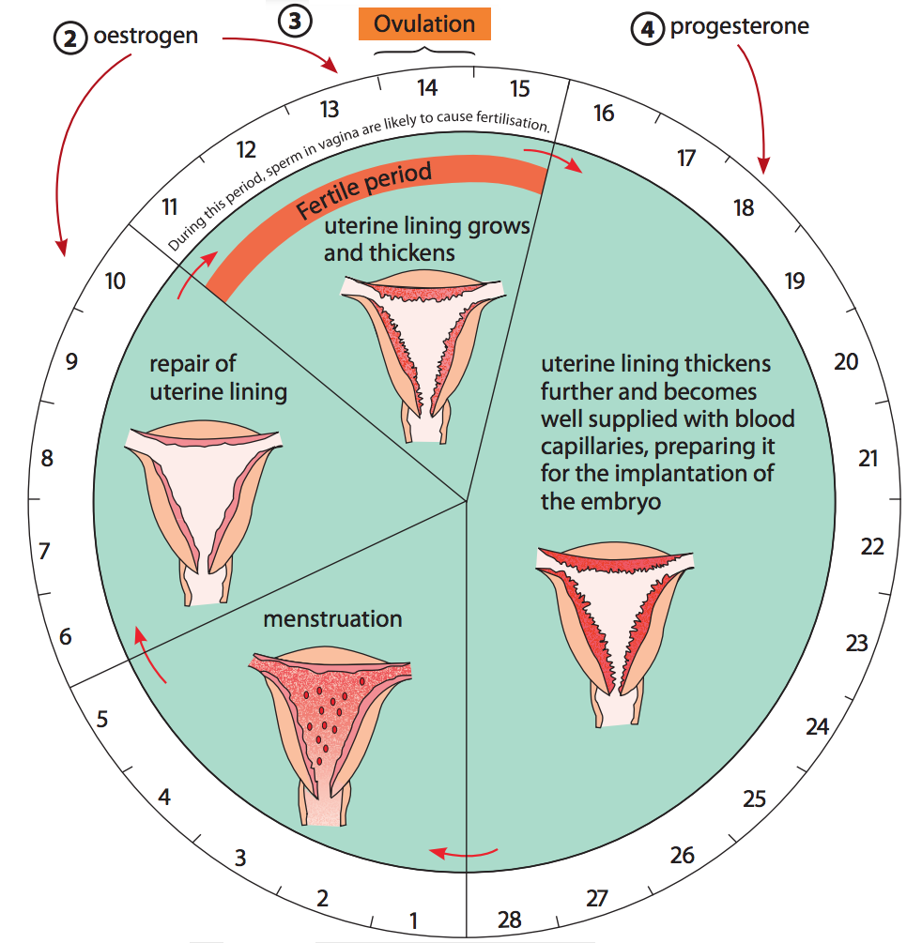
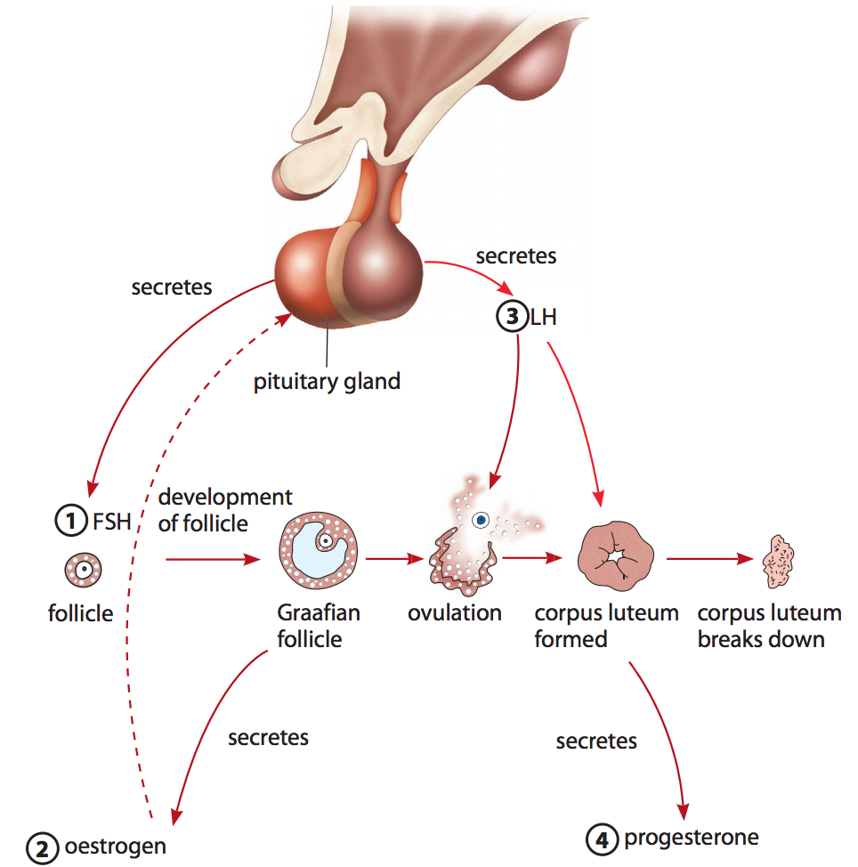
What are the stages in the menstrual cycle?
Summary of changes during a menstrual cycle of 28 days, assuming ovulation occurs on day 14
Notes:
Explain to students the stages in the menstrual cycle using the diagrams (Figure 17.9 on Student's Book p. 299).

Slide 16
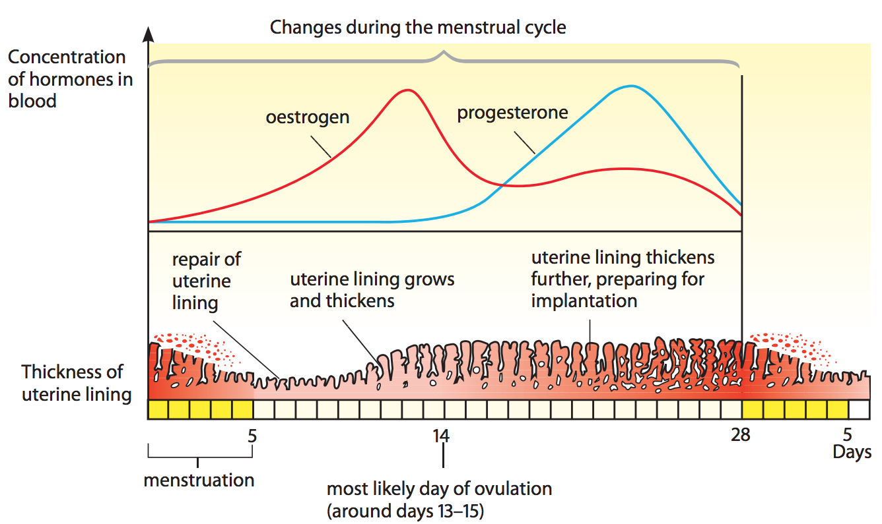
What are the changes of the hormones and uterine lining during the menstrual cycle?
The human menstrual cycle
Notes:
Discuss with students the changes of the hormones and uterine lining during the menstrual cycle using the diagram (Figure 17.10 on Student’s Book p. 300).
Have students answer the question in Quick Check on Student’s Book p. 300.

Slide 17
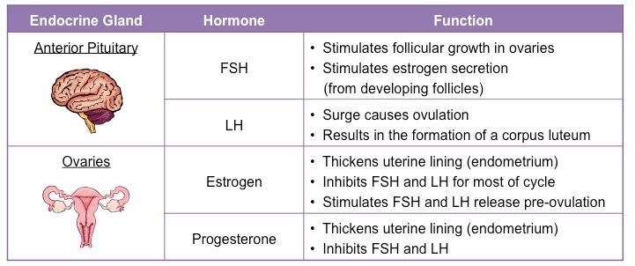
Hormones during menstrual cycle

Slide 18
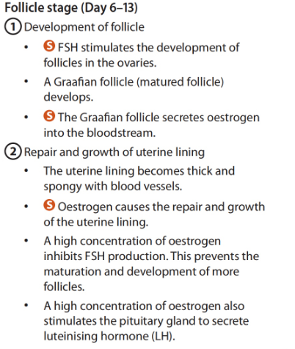
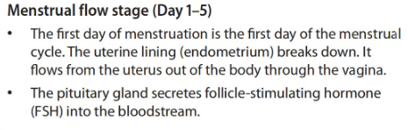
Stages of the menstrual cycle
1- Menstruation 2- Follicular Phase

Slide 19
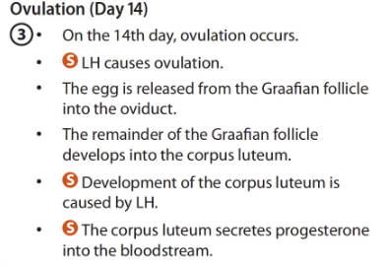
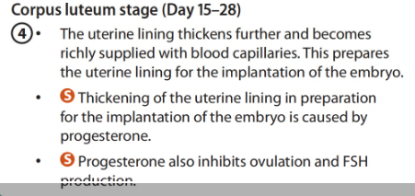
Stages of menstrual cycle
3- Ovulation 4- Luteal phase

Slide 20

What happens if no fertilisation occurs?
The egg breaks down.
The corpus luteum breaks down and blood progesterone level decreases.
On the 28th day, without progesterone, the uterine lining begins to break down. Menstruation begins again.
The whole cycle repeats.
What happens if fertilisation occurs?
The fertilised egg becomes a zygote. The zygote develops into an embryo.
The embryo embeds itself in the uterine lining.
The embryo secretes a hormone that prevents the corpus luteum from breaking down until a structure called the placenta is formed.
The corpus luteum secretes progesterone and oestrogen until the placenta is able to take over hormone production.
Notes:
Explain to students what would happen when fertilisation does not occur and when fertilisation occurs.

Slide 21
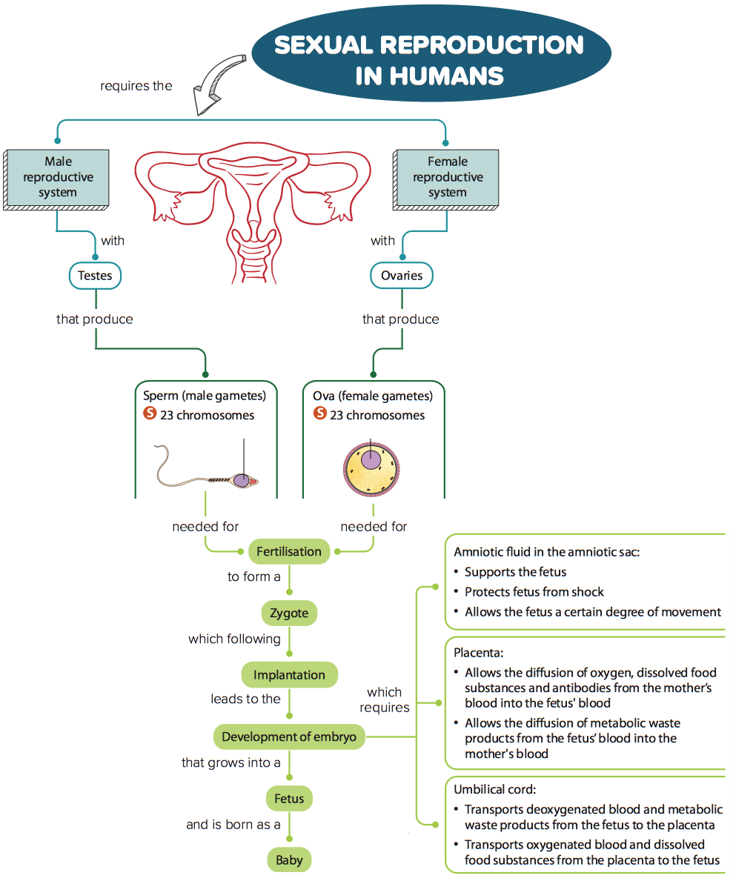
Fertilisation
and
Development
Notes:
Outline the learning aims of this section.

Slide 22
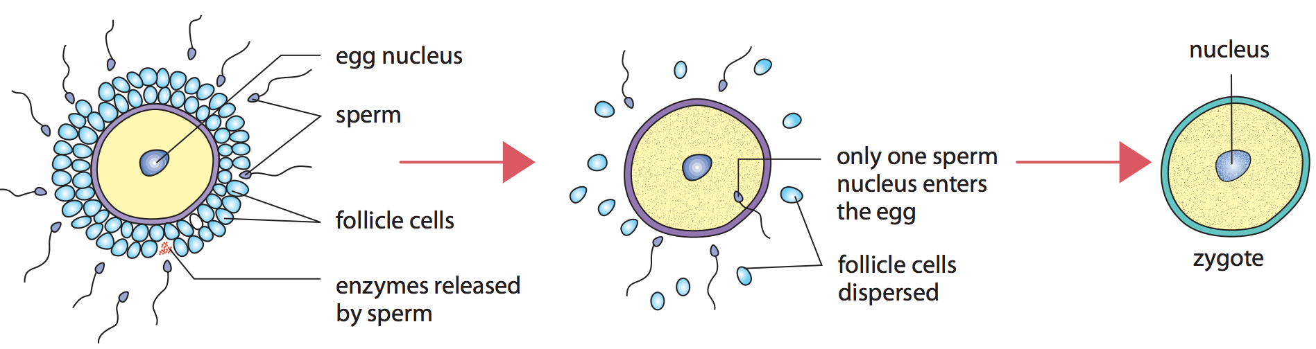
Mating or sexual intercourse
When a male’s penis is placed inside the vagina of a female, this is known as mating, copulation or sexual intercourse.
Fertilisation
Fertilisation
Notes:
Explain to students what mating or sexual intercourse is.
Explain to students the process of fertilisation using the diagram (Figure 17.11 on Student's Book p. 301).

Slide 23
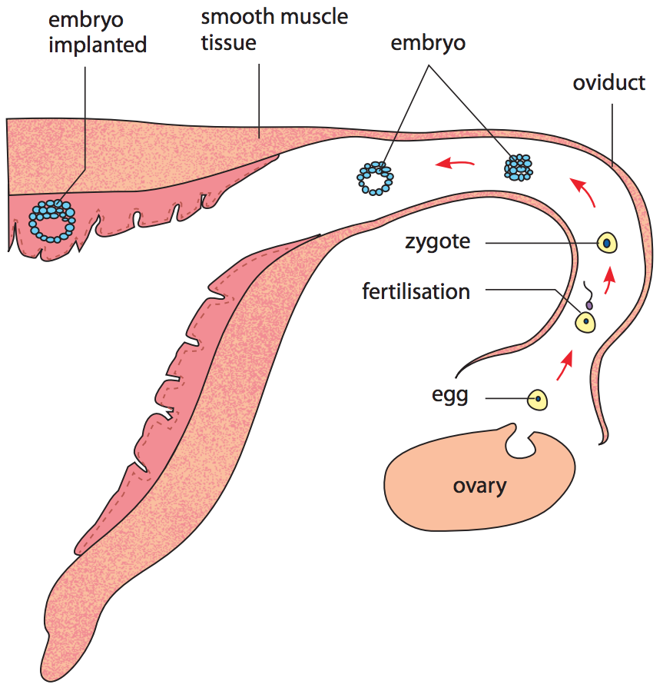
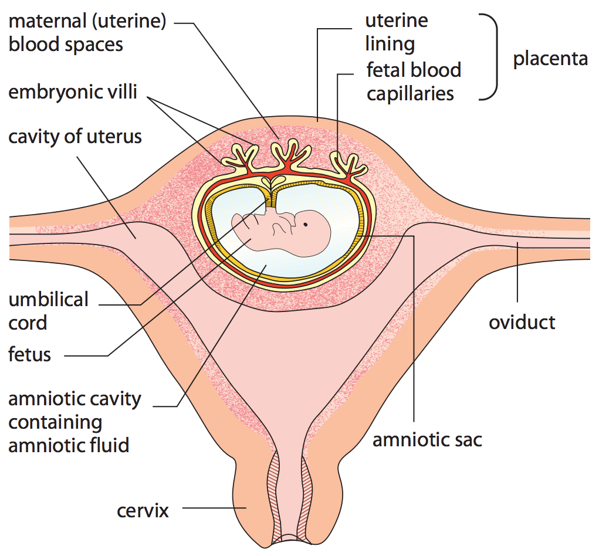
How does the embryo develop after fertilisation?
Implantation
Development of placenta and amniotic sac
Early stages of embryo development
Placenta and amniotic sac development in the uterus
Notes:
Discuss with students the development of the embryo by explaining implantation and development of placenta and amniotic sac using the diagrams (Figures 17.12 and 17.13 on Student's Book p. 302).
Have students answer the question in Quick Check on Student’s Book p. 302.

Slide 24
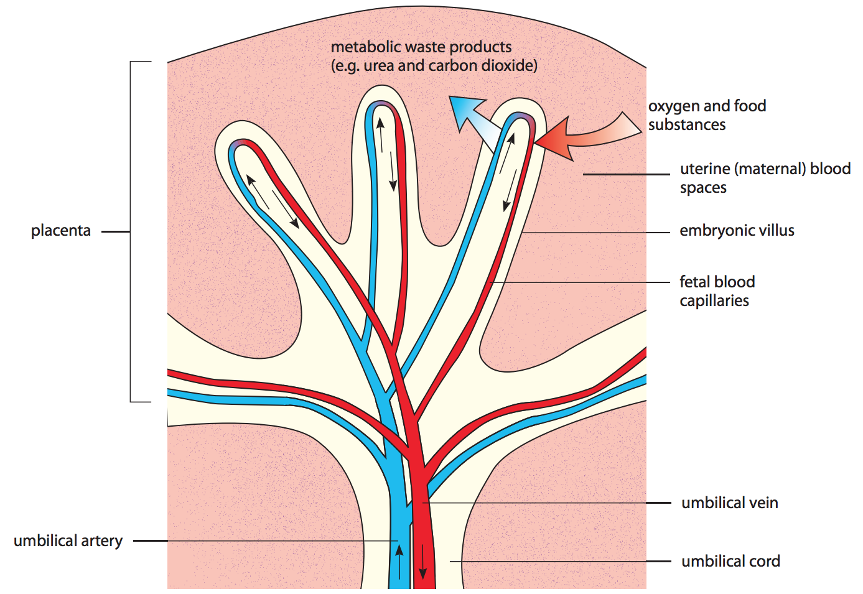
What are the functions of the placenta, umbilical cord and amniotic fluid?
Placenta
Allows oxygen, dissolved food substances and protective antibodies to diffuse from the mother’s blood to the fetus’ blood.
Allows waste or excretory products to diffuse from the fetus’ blood to the mother’s blood.
Produces oestrogen and progesterone.
Umbilical cord
Amniotic fluid
Supports the fetus before birth.
Protects the fetus against physical injury.
Allows the fetus a certain degree of movement.
Lubricates and reduces friction in the vagina during birth.
Part of the placenta showing the umbilical artery and vein (Only one umbilical artery is shown.)
Notes:
Explain to students the functions of the placenta and umbilical cord by referring them to the diagram (Figure 17.14 on Student's Book p. 303).
Explain to students the functions of amniotic fluid.

Slide 25
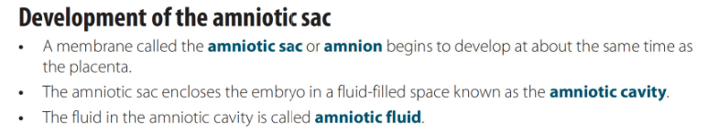
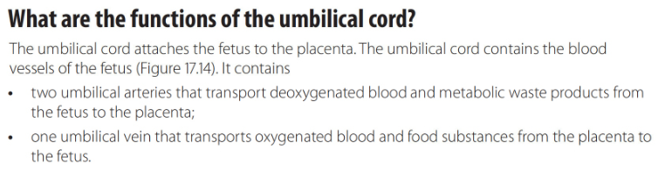
What are the functions of the placenta, umbilical cord and amniotic fluid?

Slide 26
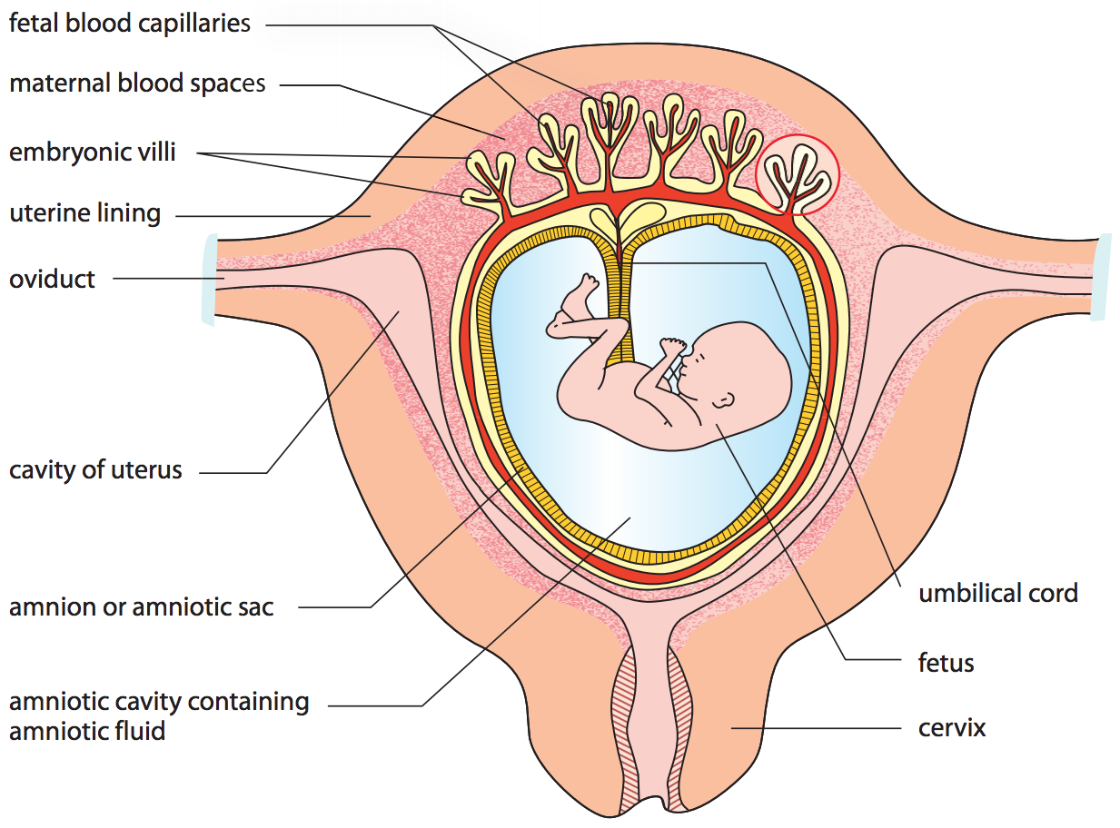
The fetal blood system is separated from the maternal blood system
1- The mother’s blood pressure can damage the delicate vessels of the embryo.
2- The placenta is able to select substances to pass into the embryo’s blood.
3- Blood of mother and embryo don’t mix, particularly in case of different blood groups.
Section showing fetus in the uterus
Notes:
Explain to students how and why the fetal blood system is separated from the maternal blood system using the diagram (Figure 17.15 on Student’s Book p. 304).

Slide 27
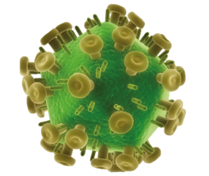
What is Acquired Immune Deficiency Syndrome (AIDS)?
Human Immunodeficiency Virus (HIV) is a virus (pathogen) that causes the most widely know sexually transmitted infection (STI), Acquired Immune Deficiency Symdrome (AIDS).
Signs and symptoms of AIDS
chronic or persistent fever;
severe diarrhoea lasting for months;
pneumonia;
cancer of the blood vessels;
brain infection;
widespread tuberculosis.
“Knobs” on the surface of HIV allows the virus to attach to cells.
Notes:
Introduce to students AIDS and discuss the signs and symptoms of AIDS.

Slide 28
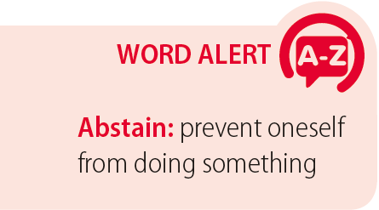
What is Acquired Immune Deficiency Syndrome (AIDS)?
Modes of transmission
Sexual intercourse with an infected person
Sharing hypodermic needles with an infected person
Blood transfusion with blood from an infected person
During pregnancy, the virus may pass from the infected mother to the fetus.
Prevention and control
Keep to one sex partner or abstain from having sex.
Males should wear a condom if they are not sure whether their partner(s) or themselves are infected with HIV.
Do not share instruments that are likely to break the skin and be contaminated with blood.
Go to reliable operators if you require acupuncture treatment, ear-piercing or tattooing.
Notes:
Explain to students the modes of transmission and prevention and control of AIDS.
Have students answer the Quick Check question on Student’s Book p. 306.
Highlight the term in Word Alert on Student’s Book p. 306.

